Slide 1
Blurring the line between criminal law and immigration law – EU framework
29 November 2023

Slide 2
Focus on
How the conflation of criminal and administrative law is reflected in the ongoing negotiations around the EU Pact on Migration and other key migration reforms.
The use of criminal law to manage migration: the Commission’s new initiative to revise the EU legislative framework.

Slide 3
1. The EU Migration Pact and other key migration reforms
Detention of migrants for reasons related to ‘national security’ or ‘public order’
Recast Return Directive proposal (2018)
‘Risk to public policy, public security or national security’ as a new ground for detention.
Asylum Procedure Regulation (2016 & 2020)
Expanded use of border procedures (for asylum and return), likely to entail de facto detention.
Mandatory use of border procedures when the applicant poses a ‘risk to national security or public order’.
Inclusion of unaccompanied children and children above the age of 12 with family members if considered a risk on these grounds.

Slide 4
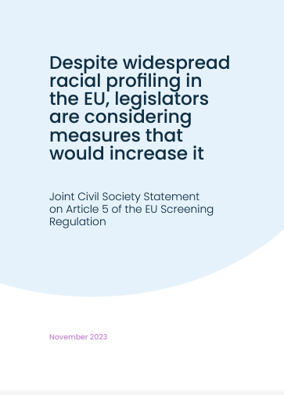
1. The EU Migration Pact and other key migration reforms
Harmful narratives on migration as a ‘threat’
Screening Regulation proposal (2020)
Likely to entail arbitrary deprivation of liberty.
Problematic application at the borders and within the territory – risk of racial profiling.
Revision of the Schengen Borders Code (2021)
‘Large scale’ irregular migration in the definition of what constitutes a ‘serious threat’ which would justify the reintroduction of internal border controls within the Schengen Area.

Slide 5
2. Use of criminal law to manage migration to prevent and deter people’s mobility
New proposal to revise the Facilitators’ package
Two proposals presented on 28 November:
Directive laying down minimum rules to prevent and counter the facilitation of unauthorised entry, transit and stay in the Union (replacing the Facilitators’ package)
Regulation to reinforce Europol's role and inter-agency cooperation in the fight against migrant smuggling and trafficking in human beings.
Effective measures against criminalisation of migrants and humanitarian assistance?

Slide 6
Thank you!
Silvia Carta– Advocacy Officer
silvia.carta@picum.org
www.picum.org

