Slide 1
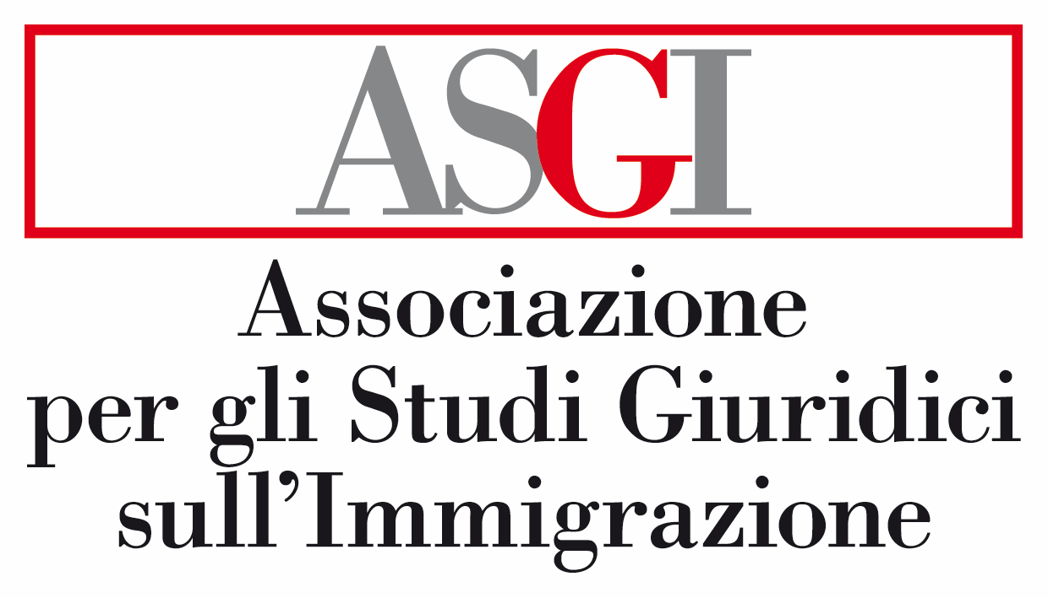

Blurring the line between criminal law and immigration law – EU framework
Ulrich Stege
29th NOVEMBER 2023

Slide 2

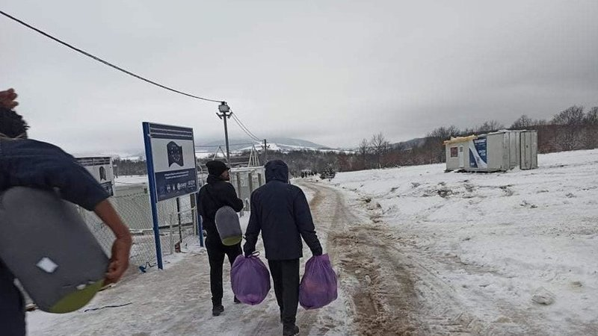
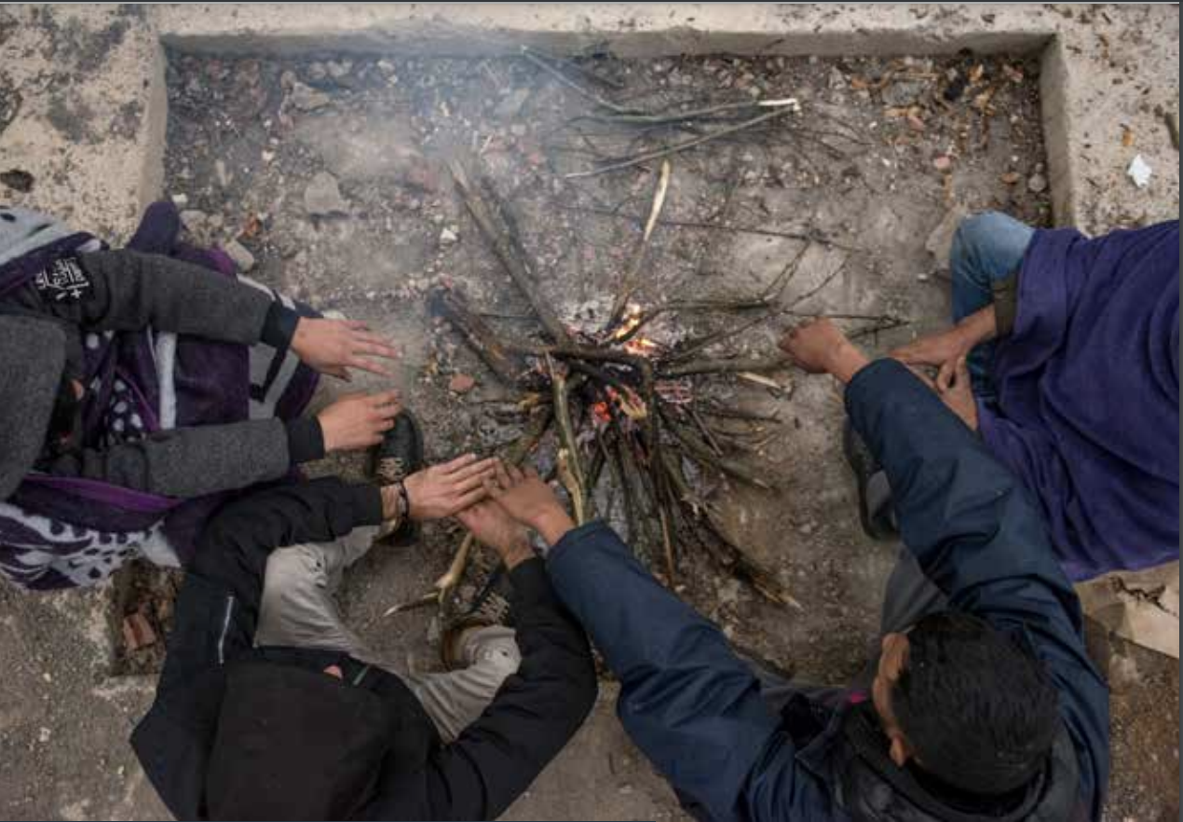
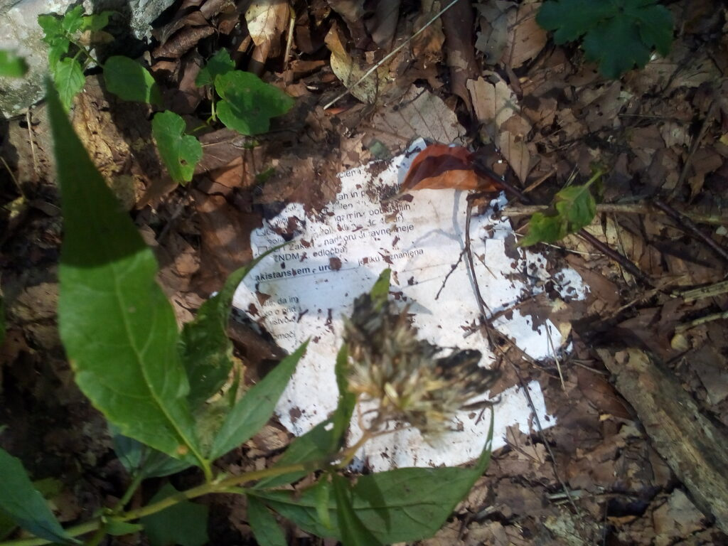
The ASGI (Association for Juridical Studies on Immigration) Medea project
→ Medea is a strategic action based on field research, strategic litigation and advocacy aimed at defending the rights of foreign citizens arriving in Italy through the internal borders and the Balkan route.

Slide 3
Trends in EU linked to crimmigration
The conflation between criminal and administrative law in the context of migration in the EU has manifested itself in particular in the following areas:
1. The use of administrative detention for security related purposes;
2. The use of criminal law as a deterrent for migration;
3. The use of technology for immigration enforcement purposes.

Slide 4
“Crimmigration”/Criminalisation of migrants → Terminologies
Administrative law system (and more particularly administrative detention) can cause migrants to be treated like criminals – Person (judged and categorised by the legal system based on their birthplace and ethnicity) considered “illegal”.
Criminalisation occurs when the effect of an administrative action by a migrant results in the migrant being considered a criminal within the criminal law jurisdiction (ex: “crime of illegal immigration”) – Act as illegal.
Administrative law has discarded its philosophical underpinnings so as to position certain groups of people outside legal philosophy in the realm of the un-legal (creating a so-called: “un-legality” or “illegality” regime).

Slide 5
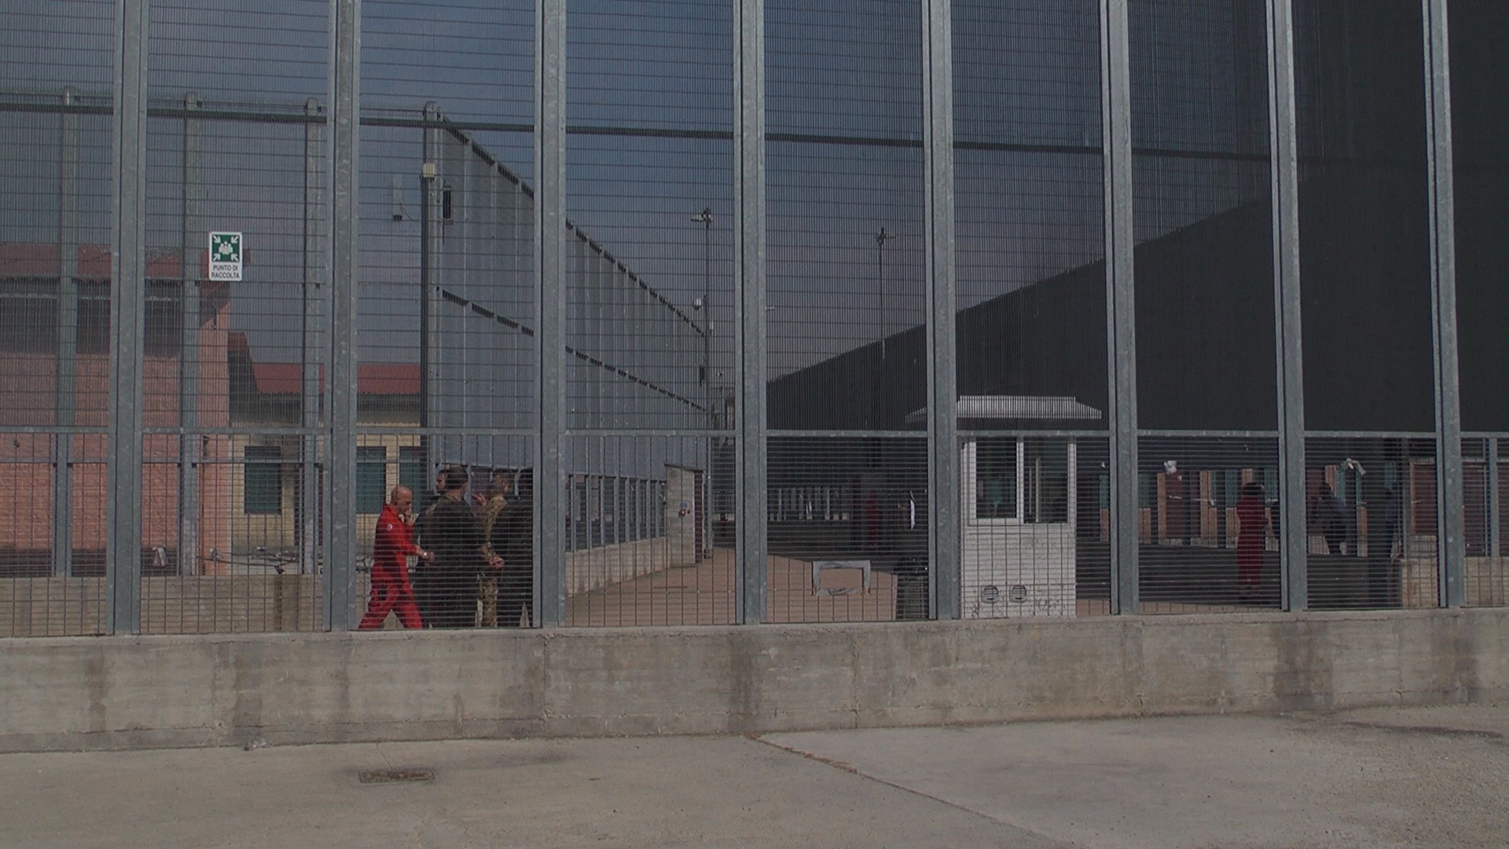
Immigration Detention in Turin/Italy

Slide 6
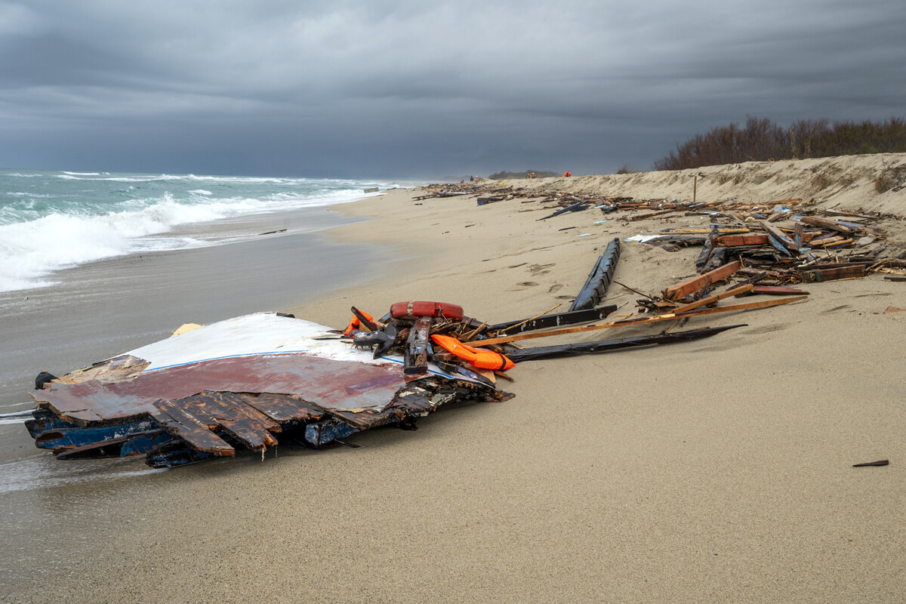
Criminal Law as a migration management tool
Cutro

Slide 7
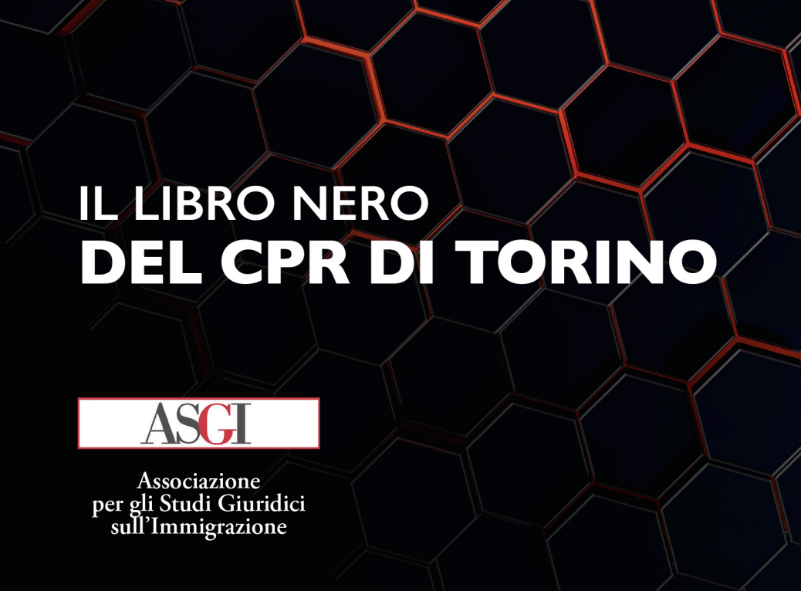
The “un-legality” or “illegality” regime
https://www.asgi.it/wp-content/uploads/2021/06/PER-SITO_-Il-libro-nero-del-CPR-di-Torino.pdf

Slide 8
THANKS
Ulrich Stege
ustege@iuctorino.it
ASGI Medea
medea@asgi.it

